Slide 1

Probabilistic programming II Jure Demšar

Slide 2

Additional variable types in Stan
// simplex is a vector of positive real numbers that sum up to 1
simplex[n] s;
// unit vector - a vector of real values with Euclidian length of one
unit_vector[n] uv;
// ordered vectors contains ascendingly ordered real numbers
ordered[n] o;
// positive ordered vector contains ordered positive real numbers
positive_ordered[n] po;

Slide 3
Additional variable types in Stan
// row vector
row_vector[n] rv;
// covariance matrices - symmetric and positive definite
cov_matrix[K] Omega;
// correlation matrices - symmetric and positive definite
// has entries between −1 and 1 and has a unit diagonal
corr_matrix[3] Sigma;

Slide 4
Additional variable types in Stan
// Cholesky factors of covariance matrices
cholesky_factor_cov[4] L;
// Cholesky factors of correlation matrices
cholesky_factor_corr[K] L;

Slide 5
Conditional statements
if (condition1)
statement1
else if (condition2)
statement2
// a comment
else if (conditionN-1)
statementN-1
/*
a comment block
*/
else
statementN

Slide 6
For loops
// this is a for loop
for (n in 1:N) {
y[n] ~ bernoulli(theta);
}
// Stan is quite smart, as you saw in our first example
// the above can be simplified (presuming y is a vector or an array)
y ~ bernoulli(theta);

Slide 7
“Foreach” loops
// if items is a container (vector, row vector, matrix, or array)
for (i in items) {
... do something with i ...
}
// for 2D arrays we require a double loop
// we can traverse matrices in a single “foreach” loop
// elements in a matrix are visited in a column-major order
real array[2, 3];
for (i in array)
for (j in i)
... do something with y ...

Slide 8
“Foreach” loops
// if items is a container (vector, row vector, matrix, or array)
for (i in items) {
... do something with i ...
}
// for 2D arrays we require a double loop
// we can traverse matrices in a single “foreach” loop
// elements in a matrix are visited in a column-major order
real array[2, 3];
for (i in array)
for (j in i)
... do something with y ...

Slide 9
While statements, break and continue
while (condition) {
if (x[n] >= 0) continue;
// if above holds the line below will be skipped due to continue
sum += x[n];
}
while (condition) {
if (x[n] >= 0) break;
// if above is true, while loop will exit
sum += x[n];
}

Slide 10
While statements, break and continue
while (condition) {
if (x[n] >= 0) continue;
// if above holds the line below will be skipped due to continue
sum += x[n];
}
while (condition) {
if (x[n] >= 0) break;
// if above is true, while loop will exit
sum += x[n];
}

Slide 11
The functions block
functions {
// custom user-defined functions
... function declarations and definitions ...
}
This block is placed at the top of your Stan program.
In it you can code up any custom functions that will help you in your work.

Slide 12
The transformed data block
transformed data {
// mathematical transformations of the data
... declarations ...
... statements ...
}
This block is used to perform any transformation on the input data from the data block.
After transformations (e.g. normalization, standardization ...) are completed, Stan checks if transformed data meets the boundaries, we set on declared variables. If we violated our own constraints Stan errors out.

Slide 13
The transformed parameters block
transformed parameters {
// mathematical transformations of model’s parameters
... declarations ...
... statements ...
}
This block servers a similar purpose as the transformed data block, except that this time we are transforming model’s parameters.
Transformed parameters are part of model’s output.
After statements are executed, Stan check the constraints we provided. If the parameter does not meet the constraints its value will be rejected.

Slide 14
The generated quantities block
generated quantities {
// additional generated outputs
... declarations ...
... statements ...
}
This block is rather different then other blocks as nothing in it affects the sampled parameter values.
This block is executed after a sample is generated, in it we can use model’s variables to generate custom quantities we are interested in (e.g. posterior event probabilities, comparisons between parameters, log likelihoods ...).

Slide 15
Log posterior probability
In the Bayesian setting a probabilistic program is a description of how to compute the posterior distribution. The essence of computation in Stan is dealing with the logarithm of the posterior probability density.
In practice y[i] ~ normal(mu, sigma); multiplies the current posterior probability by the density of the normal distribution at y[i].
This is the same as an increment of current log-probability by the log-density of the normal distribution at y[i].
Indeed, we can replace y[i] ~ normal(mu, sigma); with target += normal_lpdf(y | mu, sigma) .

Slide 16
Hands on examples

Slide 17
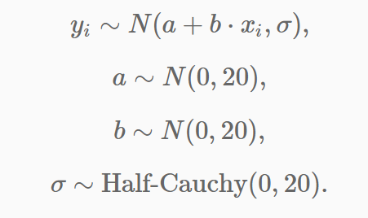
Presenting models

Slide 18
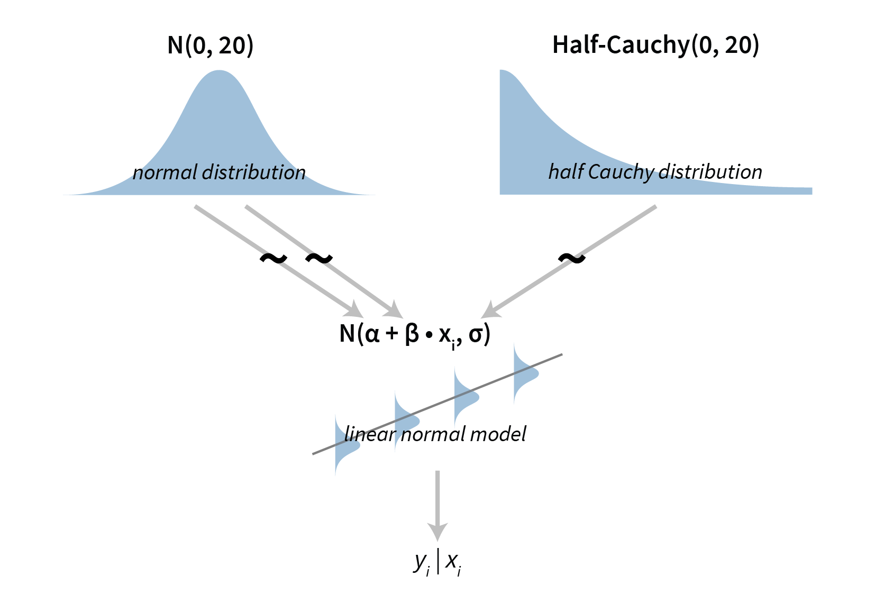

Slide 19
Questions, problems … jure.demsar@fri.uni-lj.si

